Slide 1
Touch Sensor
Light Sensor &&
Sound Sensor < 60
Going Straight
Scream
Finished Turning
(Sound Sensor > 93) ||
(Light Sensor & Sound Sensor > 60)
Wall Turn
Found Princess
Complete
Sound < 60
Finished Turning
Current Sound <
Loudest Sound – 15
Circle Search
10 Minutes
Leave Area

Slide 2
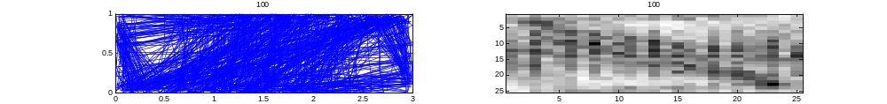
Random Walk Density, 100 degree turns after each wall bounce in a 3x1 rectangle (like the hall)

